Slide 1
My Kindergarten Sight Words

Slide 2
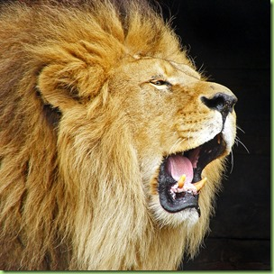
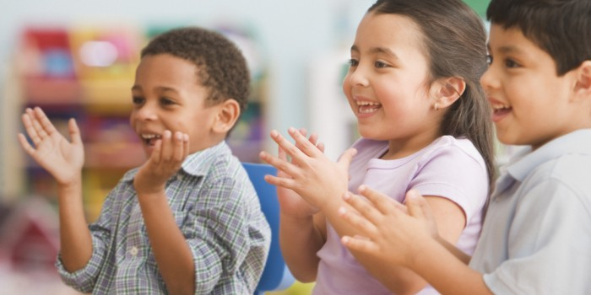
Directions:
Read the sight word out loud.
If you see a lion ROAR!
If you see children CLAP!

Slide 3
the

Slide 4
I

Slide 5
to

Slide 6
a

Slide 7
is

Slide 9
my

Slide 10
go

Slide 12
me

Slide 13
like

Slide 15
on

Slide 16
in

Slide 18
so

Slide 19
we

Slide 20
it

Slide 21
and

Slide 22
up

Slide 24
at

Slide 26
see

Slide 27
he

Slide 29
do

Slide 30
you

Slide 31
an

Slide 33
can

Slide 34
no

Slide 36
am

Slide 37
said

Slide 38
went

Slide 40
are

Slide 41
this

Slide 42
go

Slide 44
go

Slide 45
look

Slide 46
for

Slide 48
get

Slide 49
come

Slide 50
got

Slide 51
play

Slide 53
was

Slide 54
had

Slide 55
they

Slide 56
will

Slide 57
too

Slide 58
all

Slide 60
be

Slide 61
as

Slide 62
ball

Slide 63
by

Slide 64
day

Slide 66
did

Slide 67
has

Slide 69
her

Slide 70
him

Slide 71
fun

